Slide 1
Sentiment Analysis Of text data using multiple models
Natan Najera Torres, Annalee Nersten, Ayden Garrett, Ryan Brombaugh
CS 440 – Group 20 – 04/28/2026

Slide 2
Problem statement
Sentiment analysis is the analysis of a piece of text to determine positive or negative user sentiment.
The goal is to classify text as positive or negative using machine learning
Used in:
Product Reviews
Social Media
Feedback Systems

Slide 3
WHY it is useful
The ability to quickly and efficiently determine user sentiment surround some product, business, media allows for:
User/Consumer opinion
Quick reaction to positive and or negative sentiments
Understand and analyze complex opinions in aggregation

Slide 4
Datasets Used
Yelp Open Dataset
~12,000 businesses, with name location, and associated yelp reviews
Millions of written customer Yelp reviews for individual businesses
IMDB Dataset
Dataset of 50,000 labeled (positive/negative) written IMDB movie reviews.
GloVe (Global Vectors for Word Representation)Word Vectors
400,000 word embeddings mapped to numerical vectors
Maps similarity to words to each other, and which worse tend to appear together

Slide 5
Preprocessing and Cleaning
Text Standardization
Removes punctuation and separates contractions.
Lemmatization
Groups similar words into a single word (Walked, Walking -> Walk)
Negation System
Positive or negative words with negation word in front of them (Ex: not good, not bad) get a negation tag to flip their contributions to sentiment score.

Slide 6
Approach
We focused on the creation of a few NLP (Natural Language Processor) models to determine user sentiment. This allowed our group to:
Allow raw text to be converted to classifiable data
Utilize machine learning to comprehend words in context
Measure certainty and ambiguity in written reviews
Extract meaning from written words using machine learning

Slide 7
CNN
Our team utilized a Convolutional Neural Network to do the bulk of the analysis and classification for written reviews. The CNN model's main advantage for this project was its ability to capture local context within reviews. This process was accomplished by:
Tokenizing written Yelp reviews
Vectorizing existing tokens using GloVe to determine meaningful tokens
Use Convolutional filters to capture the strength of user sentiment across tokens
Grade tokens and phrases with the highest and lowest sentiment scores

Slide 8
Gradient Boosting
Gradient Boosting served as a measurement against the CNN to determine token ambiguity.
Should CNN label a token as positive and Gradient Boosting label the same token as negative the token is label ambiguous
Should CNN label a token as negative and Gradient Boosting label the same token as negative the token is not labeled ambiguous

Slide 9
Naïve Bayes
Naïve Bayes was used in this project to create concrete sentiment scores for individual tokens where CNN does not
Something like 'amazing':
P(amazing | positive/negative) - How often does this word appear in positive or negative reviews
Allows for specific token classification
Provides our project with important key words detected throughout reviews

Slide 10
Evaluation metrics
Our group utilized multiple different metrics to determine the effectiveness and accuracy of our models:
Accuracy – Percentage of correct vs total predictions of a given model
Precision – A models correct predictions against all predictions
Recall – The amount of false negatives a model catches
F1 Score – Measurement between a models precision and recall
ROC Curve – A models true positive vs false positive rate

Slide 11
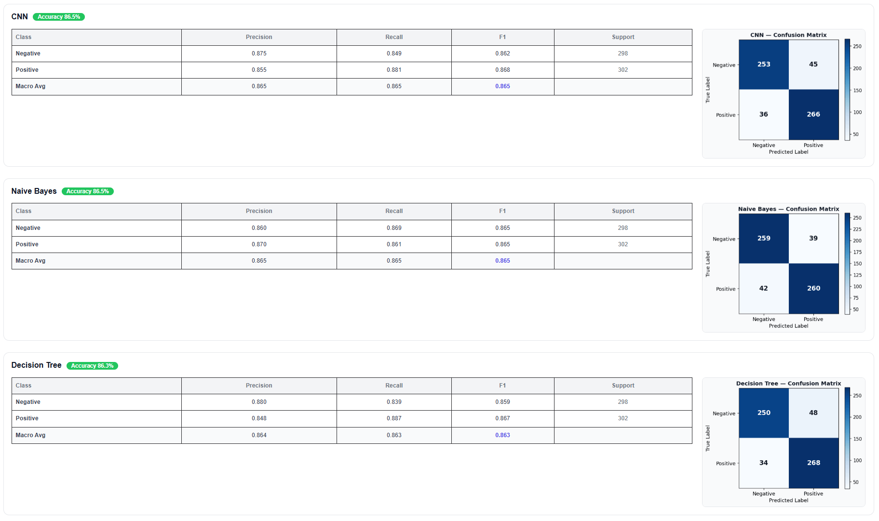
Results

Slide 12
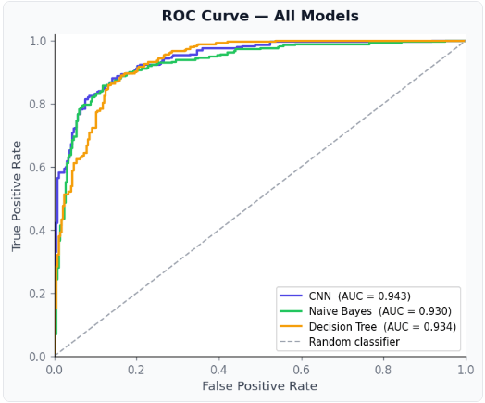
Results

Slide 13
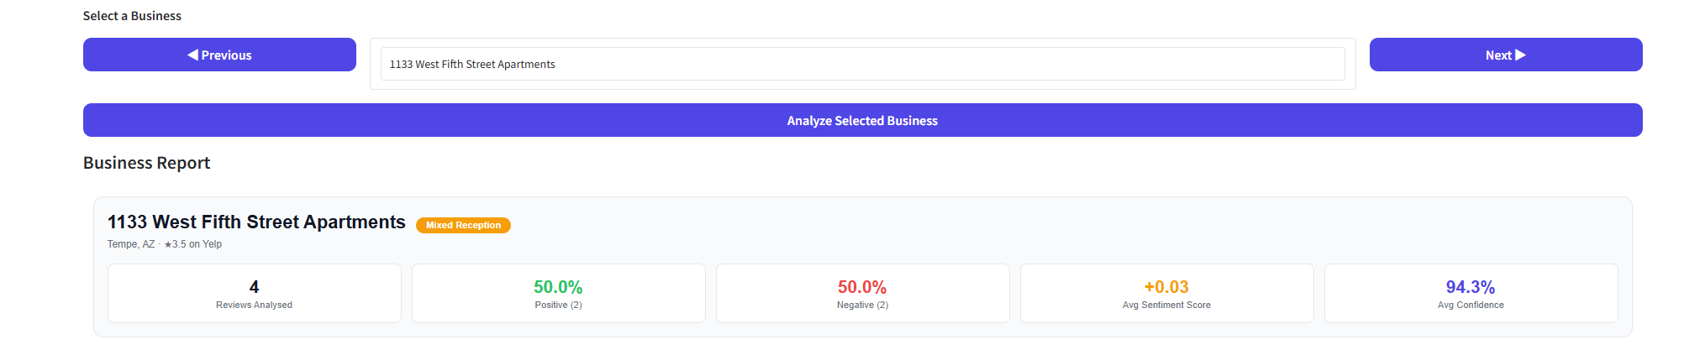
Business overview

Slide 14
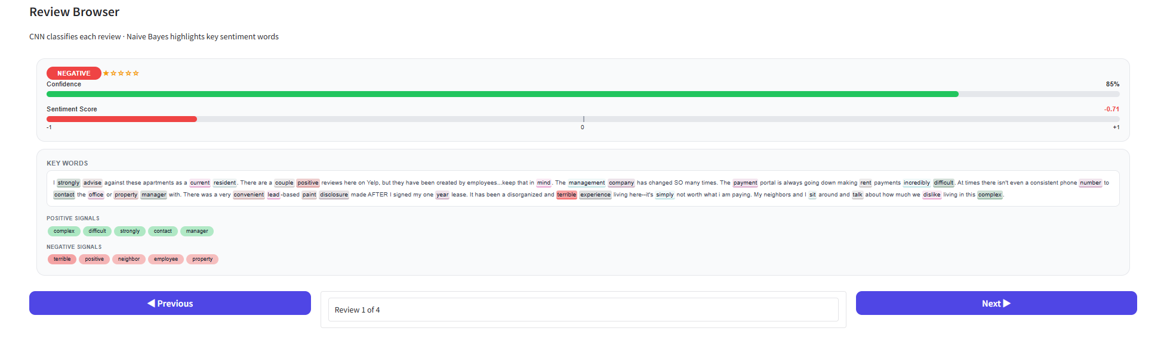
Review sentiment analysis - Negative

Slide 15
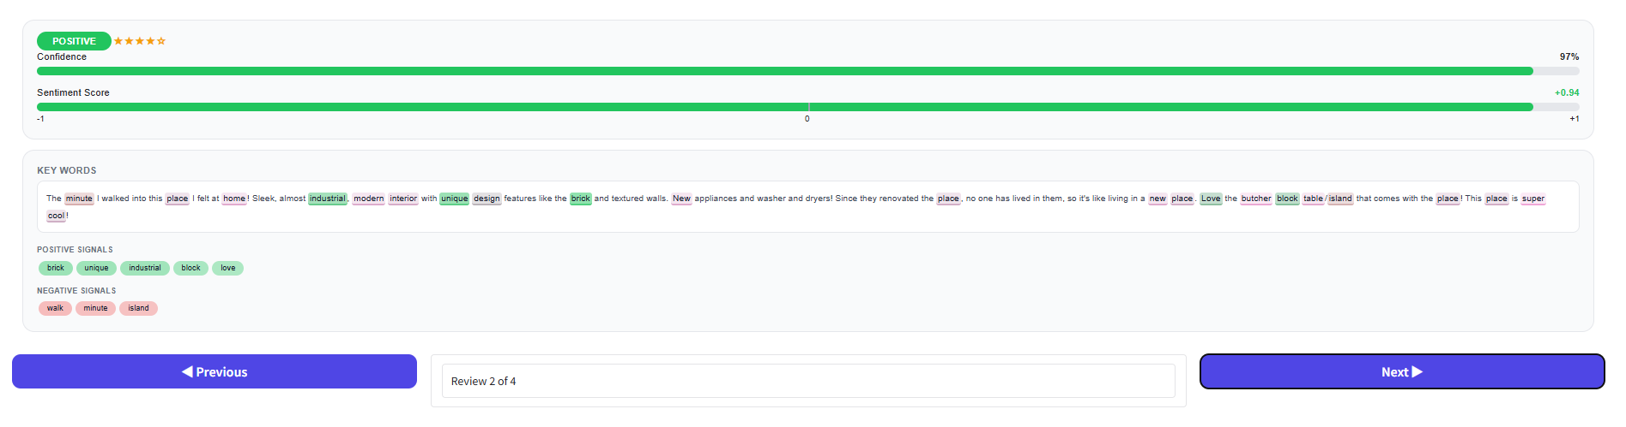
Review sentiment analysis - positive

Slide 16
Conclusion
CNN performed best overall, captures local context and capturing sentiment in a review
All models achieved ~85%-87% accuracy
Sentiment analysis is effective across multiple approaches:
The project as is now can be extended to more and diverse datasets, amazon reviews, movie reviews, social media posts, etc., to determine and measure user sentiment.
Sentiment Analysis using machine learning provides us with a powerful tool in understanding how wider groups engage with a multitude of different platforms and products.

